Slide 1
RDD Loading/Writing from HDFS

Slide 2
Reading File from HDFS into RDD:
sc.textFile → Text File
sc.sequenceFile → Sequence File
Writing data into HDFS From RDD:
saveAsTextFile
saveAsSequenceFile

Slide 3
RDD : Save as a Text File
saveAsTextFile(path, compressionCodecClass=None)
Save this RDD as a text file.
The list of supported Codecs will be found at core-site.xml.
Ex – Find the number of customers placed order in July or Aug Month. Store the output at HDFS as a text format. Create 5 files. Compression format should be bzip2.
ord = sc.textFile('practice/retail_db/orders')
julyOrd = ord.filter(lambda x : str(x.split(',')[1].split('-')[1]) == '07‘)
augOrd = ord.filter(lambda x : str(x.split(',')[1].split('-')[1]) == '08') julyAugOrders = julyOrd.union(augOrd).distinct()
julyAugOrders.coalesce(5).saveAsTextFile('practice/retail_db/dump/julyAugOrders', compressionCodecClass='org.apache.hadoop.io.compress.BZip2Codec')

Slide 4
RDD : Save into a SequenceFile
saveAsSequenceFile(path, compressionCodecClass=None)
A sequence File is a collection of tuple of Key-Value Pair.
Its flat binary file type that serves as a container for data to be used in Hadoop distributed computing projects and Map Reduce.
#Extract rdd to sequence file
Ex – Fine the number of customers placed order in July or Aug Month. Store the output at HDFS as a sequence file format. Create 1 file. No Compression is required.
JulyAugOrdPair = julyAugOrders.map(lambda r : (r.split(',')[0],r)) JulyAugOrdPair.coalesce(1).saveAsSequenceFile('practice/retail_db/dump/julyAugOrders')
#Keys can also be None if you do not have a suitable key.
JulyAugOrdPair = julyAugOrders.map(lambda r : (None,r))
#Load a sequence file into rdd
rdd = sc.sequenceFile('practice/retail_db/dump/julyAugOrders')

Slide 5
Spark Cluster Execution Architecture

Slide 6
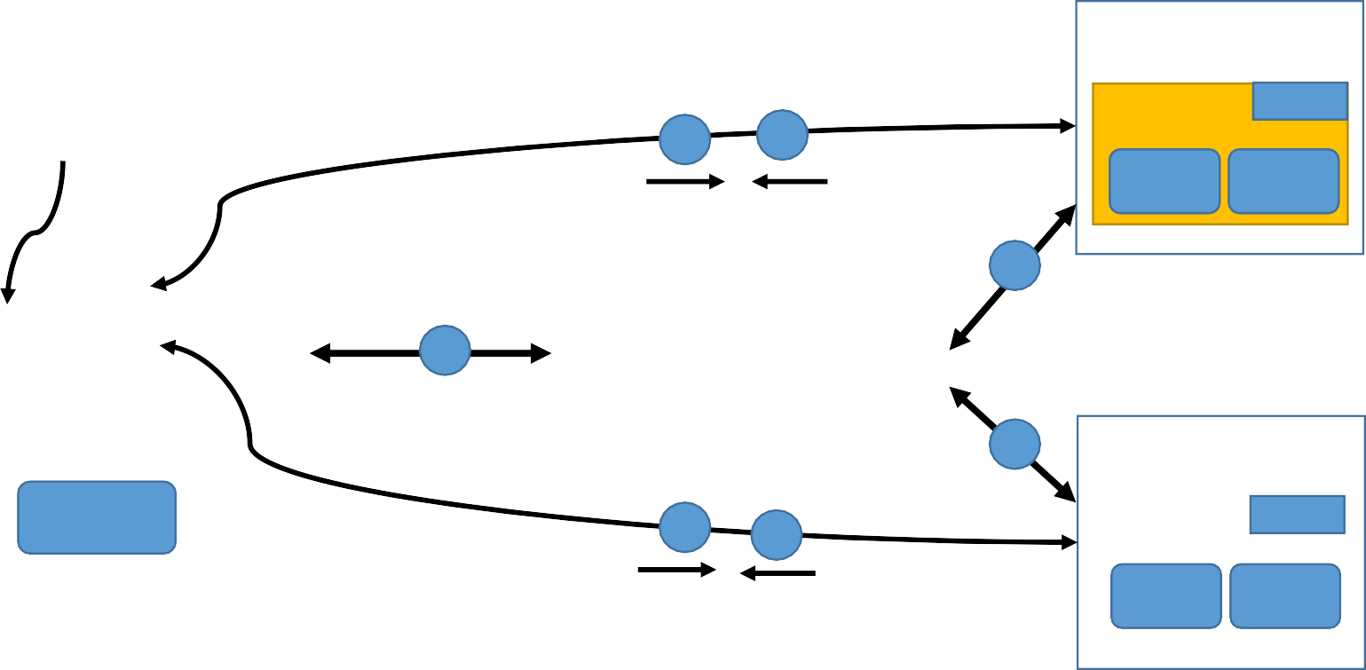











Spark Execution Architecture
Driver Program
Worker Node
8
9
Executor
Cache
1
Task
Task
2
7
JVM
3
Spark Context
Cluster Manager
6
7
Worker Node
Action Operation
8
9
Executor
Cache
Task
Task
DAG Scheduler
4
Task Scheduler ₅
task1
RDD
task2
RDD1
RDD2
Tasks
Operator DAG
task3
RDD
task4
Launch task via Task Scheduler

Slide 7
Follows master-slave architecture.
Client submits user application code to Driver. (1)
JVM Is created on the driver. (2)
Spark Context is created in the JVM of driver program. Only one active sc per JVM. (3)
Driver implicitly converts the user code into logically DAG(Directed Acyclic Graph) using DAG scheduler. (4)
DAG Scheduler performs optimizations such as pipelining transformations and then it converts the logical graph DAG into Physical executing plan with many stages.
After creating physical executing plans, it creates Physical executing units called tasks under each stage.
The stages pass on to Task Scheduler. It launces task through cluster manager. (5)
Now driver via Spark Context talks to the cluster manager and negotiates resources. It request for worker nodes and executors in the cluster. (6) (7)
Spark is agnostic to the underlying cluster manager. As long as it can acquire executor processes, and these communicate with each other, it is relatively easy to run it even on a cluster manager that also supports other applications (e.g. Mesos/YARN).
Cluster Manager allocate resources and instruct executors to execute the job.
Also track the submitted jobs and report back the status of the job to the driver.
Driver sends application code and dependencies(defined by jar or Python files passed to the SparkContext) to executors. (8)
Finally driver also send the tasks to the executors to run.
Job resources which we are trying to pass as part of execution can be cached at Worker Nodes. One of the job
resource can be our code itself.
All the executors start to register themselves with the drivers so that driver will have a complete view of the executors.
Executors now start executing the tasks that are assigned by the driver program.
When application is running, the driver program will monitor the set of executors that runs. Driver also schedules the future
tasks based on data placement.
▪ After execution, the result returns back to the Spark Context. (9)

Slide 8
Cluster Manager Types:
The system currently supports several cluster managers:
Standalone – a simple cluster manager included with Spark that makes it easy to set up a cluster.
Apache Mesos – a general cluster manager that can also run Hadoop MapReduce and service applications.
Hadoop YARN – the resource manager in Hadoop 2.
Kubernetes – an open-source system for automating deployment, scaling, and management of containerized
applications.

Slide 9
YARN Cluster Manager

Slide 10
YARN as Spark Cluster Manager:
Yet Another Resource Negotiator for Hadoop 2.x.
Cluster Management – Used for resource allocation and Scheduling.
It has 3 major components –
Resource Manager
Node Manager
Application Master
Flow:
Client submit the Spark application. Driver instantiates SparkContext.
Driver talks to the cluster manager(YARN) and negotiates resources.
The YARN resource manager search for a Node Manger which will, in turn, launch an ApplicationMaster for the specific job in a container.
The ApplicationMaster registers itself with the resource Manager.
The ApplicationMaster negotiates containers for executors from the ResourceManager. Can request for more resources from RM.
The ApplicationMaster notifies the Node Managers to launch the containers and executors. Executor then executes
the tasks.
Driver communicates with executors to coordinate the processing of tasks of an application.
Once the tasks are complete, ApplicationMaster un-registers with the Resource Manager.

Slide 11













YARN Cluster Manager
Node Manager
3
3
Container
Driver
Resource Manager
4
5
Application
Master
1
2
8
Node Manager
6
6
Container
7
Executor
Task
Task
Node Manager
Container
7
Executor
Task
Task

Slide 12
Resource Manager:
Runs on Master Node.
Manages the resources used across the cluster.
Two components – Scheduler and Application Manager.
Scheduler - Performs scheduling based on the requirement of resources by the applications.
Application Manager: It manages the running of Application Master and restart it on its failure. Also it is responsible to accept the submission of jobs.
Node Manager:
Runs on all Worker Nodes.
Launches and monitor containers which are assigned by RM.
Responsible for the execution of the task in each data node.
Containers:
Are set of resources like RAM, CPU, memory etc on a single node and they are scheduled by RM and monitored
by NM.
Application Master:
An individual ApplicationMaster is assigned for each job by RM.
It’s chief responsibility is to negotiate the resources from the RM. It works with the Node Manager to monitor
and execute the tasks.

Slide 13
JVM Processes

Slide 14
Where JVMs are created during execution across the Clusters :
Cluster
Executor JVM
Driver JVM
JVM Heap
T
Task Slots
T
T
T
JVM Heap
T
T
Unoccupied Task Slots
Client JVM
T
Spark Context
Spark
Application
Executor JVM
JVM Heap
T
T
T
T

Slide 15
Terms used in Spark Execution Framework:
Application: User application built on Spark.
Job: A parallel computation consisting of multiple tasks that gets spawned in response to a Spark action (e.g. save, collect).
Stage: Each job gets divided into smaller sets of tasks called stages that depend on each other (similar to the map and reduce stages in MapReduce);
you'll see this term used in the driver's logs.
Task: A unit of work that will be sent to one executor.
Application Jar: A jar containing the user's Spark application codes.
Driver Program: The process running the main() function of the application and creating the SparkContext.
Cluster Manager: An external service for acquiring resources on the cluster (e.g. standalone manager, Mesos, YARN). In YARN it is Resource Manager
+ Application Master.
Deploy Mode: Distinguishes where the driver process runs. In "cluster" mode, the framework launches the driver inside of the cluster. In "client" mode, the submitter launches the driver outside of the cluster.
Worker Node: Any node that can run application code in the cluster.
Executor: A process launched for an application on a worker node, that runs tasks and keeps data in memory or disk storage across them. Each application has its own executors.
Cache: Cache is nothing but the job resources which we are trying to pass as part of execution. One of the job resource can be our code itself. Typically the code will be compiled in the jar file and jar file will be passed as cache and it will be cached into the executors. Tasks will be using this cache at the run time so that it can apply the logic onto the data while data is being processed. We can also persist or cache the RDDs.

Slide 16

One Application
Multiple Jobs for Each Application
Multiple Stages for Each Job
Multiple Jobs for
Each Application
Multiple Stages for
Each Job
Multiple tasks for
Multiple Jobs for
Each Application
Multiple Stages for
Each Job
Multiple tasks for
MEauclhtipstlaegteasks for
Each stage
Each stage

Slide 17
Narrow and Wide Transformations

Slide 18
Narrow and Wide Transformations
Narrow Transformations:
These types of transformations convert each input partition to only one output partition.
Spark merges all narrow transformations into one stage.
Fast.
No data shuffle.
Ex- map(), filter()
Partition 1
T
Partition 1
Partition 2
Partition 2
[
Partition 3
Partition 3
RDD1
RDD2

Slide 19
Wide Transformations:
This type of transformation will have input partitions contributing to many output partitions.
Each Wide Transformations creates a new stage.
Slow compared to Narrow.
Data shuffle.
Ex- groupByKey(), aggregateByKey(), join, distinct(), repartition() etc.
Partition 1
Partition 1
Partition 2
T
Partition 2
Partition 3
Partition 3
RDD1
RDD2

Slide 20
DAG

Slide 21
DAG Graph
Stage 1
Stage 2
Stage 3
Stage 4
aggregate ByKey
parallelize
parallelize
join
map
map
map
distinct
map
filter
filter

Slide 22
DAG
DAG Stands for Directed Acyclic Graph.
Directed → Directly connected to one node to another.
Acyclic → There is no cycle or loop. So it is in line and we can not go back to its original position.
Graph → It has Vertices and Edges. Vertices indicates RDDs and edges refers to the operations on the RDD. These all represented as a graph.

Slide 23








DAG Scheduler
Driver Program
Spark Context
DAG Scheduler
Physical Execution Plan
Task Scheduler
Operator
DAG
RDD1
task1
Action Operation
task5
RDD2
RDD3
task2
RDD4
task3
task6
Tasks
Logical Execution Plan
task4
task7
Stage 1
Stage 2

Slide 24
Steps to build a DAG
User submits an application job to spark.
Drivers takes the application and create a Spark Context to process the application.
Spark Context identifies all the T and A operations present in the application.
All the operations are arranged in a logical flow of operations called DAG (Logical Execution Plan).
It stops here if SC doesn’t find any A Operations.
If it identifies an A operations, spark submit the Operator DAG to DAG scheduler.
DAG Scheduler converts the Logical Execution plan into Physical Execution plan and creates stages and tasks. Here Narrow T are fused together into one stage. Wide T involving shuffle process creates new stages.
DAG scheduler bundles all the tasks and send it Task Scheduler which then submit the job to cluster manager for execution.

Slide 25
RDD Lineage
RDD Lineage:
Each RDD maintains a pointer to one or more parent along with metadata about what type of relationship it has with the parent.
Ex - if we call rdd2=rdd1.map(), the rdd2 keeps a reference to its parent rdd1 and this is called RDD lineage.
Print the RDD lineage information using toDebugString() API.
rdd1
rdd2
rdd3
rdd4
RDD Lineage Graph

Slide 26
toDebugString(self) :
Displays Logical Execution Plan.
We can learn about a RDD Lineage Graph using API toDebugString.
Displays the description of this RDD and its recursive dependencies
for debugging.
Spark Context
textFile
N T
N T
N T
W T
HadoopRDD
Word Count Program:
text_file = sc.textFile('practice/retail_db/word') wordCounts = text_file.flatMap(lambda line: line.split(",")) \
.filter(lambda x : x.isdigit() == False) \
.map(lambda word: (word, 1)) \
.reduceByKey(lambda a, b: a + b)
top3Words = wordCounts.takeOrdered(3,lambda k: -float(k[1]))
Stage 1
mapPartitionsRDD
mapPartitionsRDD
for i in rdd.toDebugString().split(“\n”) : print(i)
mapPartitionsRDD
shuffleRDD
Stage 2
A
top3Words = wordCounts.takeOrdered(3,lambda k: -float(k[1]))

Slide 27
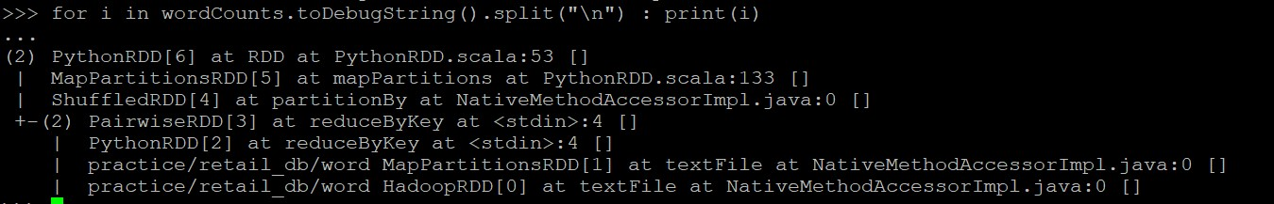
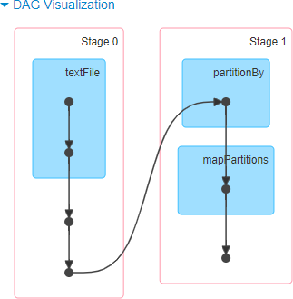
Logical Execution Plan
DAG Scheduler
Physical Execution Plan

Slide 28
Hadoop RDD
p1
p2
DAG Scheduler
mapPartitionsRDD
p1
p2
Stage 1
mapPartitionsRDD
p1
p1
Task Scheduler
mapPartitionsRDD
p1
p2
shuffleRDD
p1 p2
Stage 2

Slide 29
DAG Scheduler to Task Scheduler:
DAG Scheduler submit the stages into task scheduler.
The number of tasks submitted depends on the number of partitions present in the textFile.
For ex – imagine we have 3 partitions, then there will be 3 set of tasks created and submitted in parallel
provided there are enough cores.

Slide 30
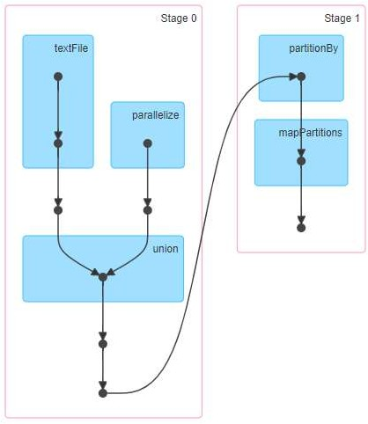
Parallel Execution of Stages:
The stages which are not dependent on each other may be submitted to the cluster for execution in parallel.
text_file = sc.textFile('practice/retail_db/orders').map(lambda x : (int(x.split(',')[0]),x.split(',')[3]))
rdd = sc.parallelize([1,2,3,4,5,6,7]).map(lambda x : (x,1*1) )
joined = text_file .join(rdd) joined.count()

Slide 31
How to find the Resource Manager URL
Go to /etc/hadoop/conf
Open yarn-site.xml
Find the resource Manager url by searching name ‘yarn.resourcemanager.webapp.address’
Default port : 8088

Slide 32
RDD Persistence

Slide 33
One of the most important capabilities in Spark is persisting (or caching) a dataset in memory.
When we persist an RDD, each node stores any partitions of it that it computes in memory and reuses them.
We can mark an RDD to be persisted using the persist() or cache() methods on it. The first time it is
computed in an action, it will be kept in memory on the nodes.
Spark’s cache is fault-tolerant – if any partition of an RDD is lost, it will automatically be recomputed using the transformations that originally created it.
Each persisted RDD can be stored using different storage level.
These levels are set by passing a StorageLevel object

Slide 34
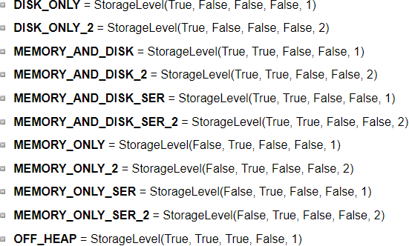
StorageLevel(useDisk, useMemory, useOffHeap, deserialized, replication=1)
Data can be stored either in Disk or Memory or off-heap memory or any of these combinations.
Data can be stored in Serialized or deserialized. Serilization is a way to convert a object in memory to series of bits. The deserialization is the process of bringing those bits into memory as an object. Whenever we are talking about 'deserialized' RDD/DF, we are always referring to RDD/DFs in memory.
Off-Heap Memory is a segment of memory lies outside the JVM, but is used by JVM for certain use-cases. Off-Heap memory can be used by Spark explicitly as well to store serialized data-frames and RDDs.
Use the replicated storage levels if you want fast fault recovery.
Default Storage

Slide 35
persist(storageLevel=StorageLevel(False, True, False, False, 1) )
Set this RDD's storage level to persist its values across operations after the first time it is computed. This can only be used to assign a new storage level if the RDD does not have a storage level set yet.
If no storage level is specified defaults to →MEMORY_ONLY.
rdd = sc.parallelize(("b", "a", "c")) rdd.persist().is_cached rdd.getStorageLevel()
from pyspark import StorageLevel
rdd.persist( StorageLevel.MEMORY_AND_DISK_2 ) rdd.getStorageLevel() print(rdd1.getStorageLevel())
unpersist():
Mark the RDD as non-persistent, and remove all blocks for it from memory and disk.
Spark automatically monitors cache usage on each node and drops out old data partitions in a least-recently-used (LRU) fashion.
If you would like to manually remove an RDD instead of waiting for it to fall out of the cache, use the RDD.unpersist() method.
rdd.persist() rdd.is_cached rdd.unpersist() rdd.is_cached

Slide 36
Usage and trade-offs:
Spark’s storage levels are meant to provide different trade-offs between memory usage and CPU efficiency.
If your RDDs fit comfortably with the default storage level (MEMORY_ONLY), leave them that way. This is the most CPU-efficient option, allowing operations on the RDDs to run as fast as possible.
When amount large amount of dataset or dataset operations are very expensive or memory is not sufficient to hold the data, spill it into disk.
Use the replicated storage levels if you want fast fault recovery

Slide 37
Spark Shared Variables

Slide 38
Shared Variables
Shared variables are the variables that are required to be used by functions and methods in parallel.
Shared variables can be used in parallel operations.
Spark provides two types of shared variables −
Broadcast
Accumulator

Slide 39
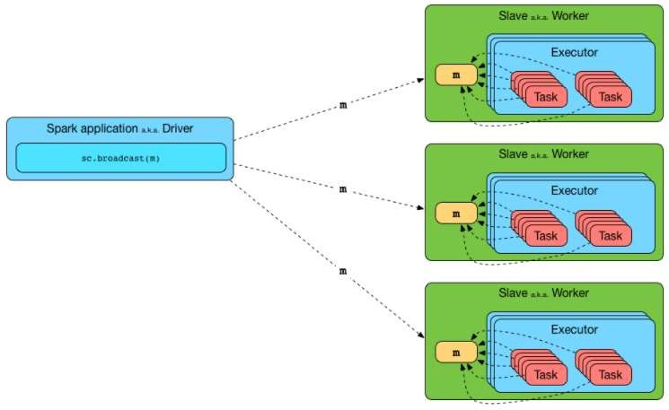
Broadcast Variables
Broadcast variables allow the programmer to keep a read-only variable cached on each machine rather than shipping a copy of it with tasks.
Immutable and cached on each worker nodes only once.
Efficient manner to give a copy of a large dataset to each node.
They should fit in memory.

Slide 40
When to use Broadcast Variable:
For processing, the executors need information regarding variables or methods. This information is serialized by Spark and sent to each executor and is known as CLOSURE.
If we have a huge array that is accessed from spark CLOSURES, for example - if we have 5 nodes cluster with 100 partitions (20 partitions per node), this Array will be distributed at least 100 times (20 times to each node). If we broadcast it will be distributed once per node using efficient p2p protocol.
What not to do:
Once we broadcasted the value to the nodes, we shouldn’t make changes to its value to make sure each node have exact same copy of data. The modified value might be sent to another node later that would give unexpected results.

Slide 41
Hands-on:
--Broadcast a Dictionary
days={"sun": "Sunday", "mon" : "Monday", "tue":"Tuesday"}
bcDays = spark.sparkContext.broadcast(days) bcDays.value
bcDays.value['sun']
--Broadcast a list
numbers = (1,2,3) broadcastNumbers=spark.sparkContext.broadcast(numbers) broadcastNumbers.value
broadcastNumbers.value[0]

Slide 42
PS: Convert the 3 bytes days into full days.
Input data= (("James","Smith","USA","mon"),
("Michael","Rose","USA","tue"),
("Robert","Williams","USA","sun"),
("Maria","Jones","USA","tue")
)
Solution:
days={"sun": "Sunday", "mon" : "Monday", "tue":"Tuesday"} bcDays = spark.sparkContext.broadcast(days)
data = (("James","Smith","USA","mon"),
("Michael","Rose","USA","tue"),
("Robert","Williams","USA","sun"),
("Maria","Jones","USA","tue")
)
rdd = spark.sparkContext.parallelize(data)
def days_convert(dict): return bcDays.value(dict)
input = rdd.map(lambda x: (x(0),x(1),x(2),x(3))).collect()

Slide 43


Accumulator Variables
Accumulator is a shared variable to perform sum and counter operations.
These variables are shared by all executors to update and add information through associative or commutative operations.
Commutative -> f(x, y) = f(y, x) Ex : sum(5 ,7 ) = sum(7, 5)
Associative -> f(f(x, y), z) = f(f(x, z), y) = f(f(y, z), x) Ex : sum(multiply(5,6),7) = sum(multiply(6,7),5)
sum(sum(5,6),7) = sum(sum(6,7),5)

Slide 44
Accumulator Variables
Why it is needed as we can use the normal variables?
counter = 0 def f1(x):
global counter counter += 1
rdd = spark.sparkContext.parallelize((1,2,3))
rdd.foreach(f1) counter.value
The counter Variable will not added or changed, because when spark ships this code to every executor the variables become local to that executor. So the variable is updated for that executor but do not send it back to the driver. To avoid this problems, we need ac accumulator. All the updates to accumulator variable in every executor is send it back to the driver.
### sparkContext.accumulator() is used to define accumulator variables
counter = spark.sparkContext.accumulator(0) def f2(x):
... global counter
... counter.add(1) ### add() function is used to add/update a value in accumulator
rdd.foreach(f1)
counter.value ### Only accessed by Driver

Slide 45
Accumulator Variables
Lets check one more example:
accum=sc.accumulator(0) rdd=spark.sparkContext.parallelize((1,2,3,4,5)) rdd.foreach(lambda x:accum.add(x)) print(accum.value) #Accessed by driver
foreach() is an action which is applied to each element of the rdd and then adding each element to accum variable.
rdd.foreach() is executed on workers and accum.value is called from driver.

Slide 46
Accumulator Variables
Spark natively supports accumulators of numeric types (int, float) and programmers can add support for new custom types using AccumulatorParam class of PySpark.
Accumulators do not change the lazy evaluation model of Spark. If they are being updated within an operation on an RDD, their value
is only updated once that RDD is computed as part of an action.
counter = spark.sparkContext.accumulator(0) def f2(x):
global counter counter.add(1)
rdd.map(f2)
Computations inside transformations are evaluated lazily, so unless an action happens on an RDD the transformations are not executed. As a result of this, accumulators used inside functions like map() or filter() wont get executed unless some action happen on the RDD. Spark guarantees to update accumulators inside actions only once.
Always use accumulators inside actions ONLY (ex – foreach).

